Slide 1

Instacart Market Basket Analysis
Group Members – Vaishnavi Patil, Atharva Chiplunkar, Maitreya Kocharekar

Slide 2
Introduction
What is Market Basket Analysis ?
It is a data mining technique used by retailers to understand the purchasing behavior of their customers. By analyzing the items that are frequently purchased together, retailers can gain insights into consumer preferences, create targeted promotions, and optimize store layouts to improve sales.

Slide 3
Introduction
In the context of Instacart, Market Basket Analysis can help identify which products are often purchased together, which products are commonly purchased by specific customer segments, and which products are typically purchased during specific times of the day or week. These insights can help Instacart optimize its product offerings, enhance customer experience, and increase sales.

Slide 4
Phase I
Dataset Description
Relational Model
ER Diagram
Loading of the dataset in PostgreSQL

Slide 5
Dataset Description

Slide 6
Relational Model

Slide 7
ER Diagram

Slide 8
Loading of our dataset

Slide 9
Phase II
Document Orientated Model
Comparison of Document Orientated Model with Relational Model
Queries
Functional Dependencies
Normalization

Slide 10
Document Oriented Model
What is Document Oriented Model?
It refers to a type of database management system that is designed to handle large volumes of unstructured or semi-structured data. Unlike traditional relational databases, which store data in tables with a fixed schema, NoSQL databases store data in a flexible, document-based format.

Slide 12
Comparison of Document Oriented Model with Relational Model

Slide 13
Queries
Query 1
SELECT p.product_id, p.product_name, COUNT(op.product_id) AS reorder_count
FROM product p
JOIN order_product op ON p.product_id = op.product_id
JOIN orders o ON op.order_id = o.order_id
WHERE op.reorder = 1
GROUP BY p.product_id,p.product_name
ORDER BY reorder_count DESC
LIMIT 10;

Slide 14
Queries

Slide 15
Queries
Query 2
SELECT d.department_id, d.department_name, AVG(o.days_since_prior_order) AS avg_days_since_last_order
FROM department d
JOIN product p ON d.department_id = p.department_id
JOIN order_product op ON p.product_id = op.product_id
JOIN orders o ON op.order_id = o.order_id
GROUP BY d.department_id, d.department_name
ORDER BY avg_days_since_last_order ASC;

Slide 16
Queries

Slide 17
Queries
Query 3
SELECT a.aisle_id, a.aisle_name, COUNT(CASE WHEN op.reorder = 1 THEN 1 END) AS total_reordered, COUNT(*) AS total_ordered,
(COUNT(CASE WHEN op.reorder = 1 THEN 1 END)* 100)/COUNT(*) AS reorder_percentage
FROM aisle a
JOIN product p ON a.aisle_id = p.aisle_id
JOIN order_product op ON p.product_id = op.product_id
GROUP BY a.aisle_id,a.aisle_name
ORDER BY reorder_percentage DESC
LIMIT 10;

Slide 18
Queries

Slide 19
Queries
Query 4
SELECT d.department_id, d.department_name, o.order_hour_of_day, COUNT(op.product_id) AS product_count
FROM department d
JOIN product p ON d.department_id = p.department_id
JOIN order_product op ON p.product_id = op.product_id
JOIN orders o ON op.order_id = o.order_id
GROUP BY d.department_id, d.department_name, o.order_hour_of_day
ORDER BY d.department_id, o.order_hour_of_day;

Slide 20
Queries

Slide 21
Queries
Query 5
SELECT p1.product_name AS product_1, p2.product_name AS product_2, COUNT(*) AS pair_count
FROM order_product op1
JOIN order_product op2 ON op1.order_id = op2.order_id AND op1.product_id < op2.product_id
JOIN product p1 ON op1.product_id = p1.product_id
JOIN product p2 ON op2.product_id = p2.product_id
GROUP BY p1.product_id,p1.product_name, p2.product_id, p2.product_name
ORDER BY pair_count DESC
LIMIT 10;

Slide 22
Queries

Slide 23
Functional Dependencies

Slide 24
Normalization

Slide 25
Phase III
Cleaning and Integration of Dataset
Itemset Mining
Which model is a best fit for our dataset

Slide 26
Cleaning and Integration of Dataset
We had already cleaned our dataset by inserting value 0 whenever we encountered null values in the attribute for example in the case of days_since_prior_order attribute of the orders table. We also converted the values for our attributes to integer and text types as required.
For data integration we created different kinds of views, one of which, view2, sorts the aisles according to departments and displays an array of aisles for each department. For this we integrated the product department and aisle table and created a view out of it to find which different aisles belong to what departments.
Similar task was done for Aisle_Product, wherein we sorted different unique products into their aisle by joining aisle and product table. This way any user can simple find the location of their desired product

Slide 27
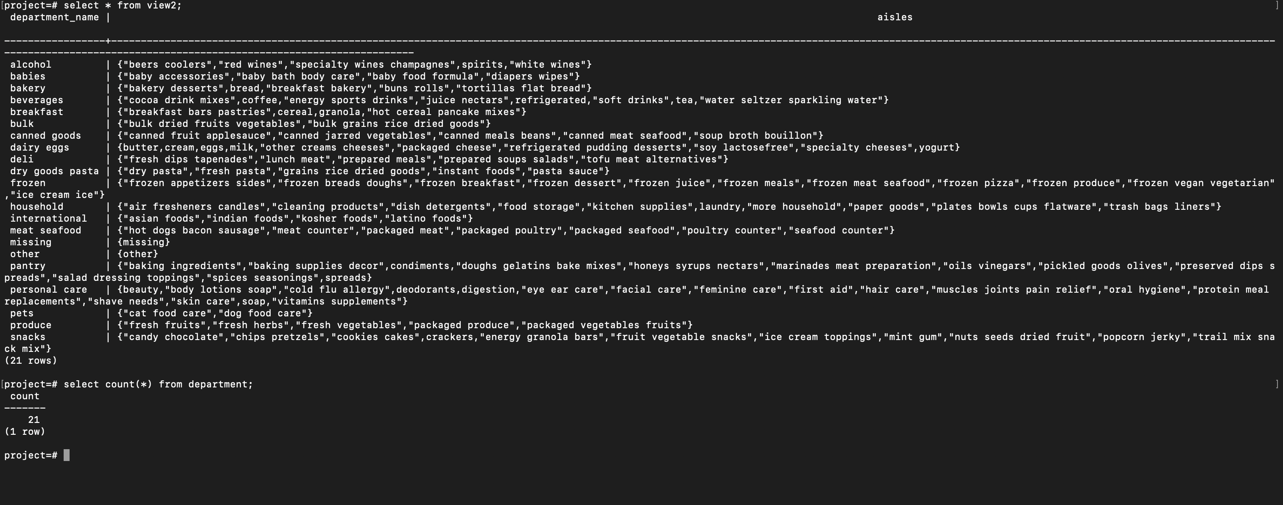

Slide 28
Itemset Mining
First, we formed a table named temp2. This table contains all the important information that we need. The table is formed by joining order and order_product table on order_id, call this newly formed table temp1, and then joining product table on the temp1 table on product_id thus resulting in our temp2 table.
We then applied itemset mining on this table for product_id, as our goal here was to find the products that were bought together frequently in multiple different orders.
The basic process is a python program that keeps on writing sql queries to form k-items lattice, till the rows in the lattices are zero or no more k number of elements are being brought together at least n number of times where n is our threshold set by us.
We have set the threshold to 10,000. This means only those elements are included who were being brought in minimum 10000 number of orders
We then take each row of the final lattice and take each unique element from them and print at the last the most frequently brought items.

Slide 29
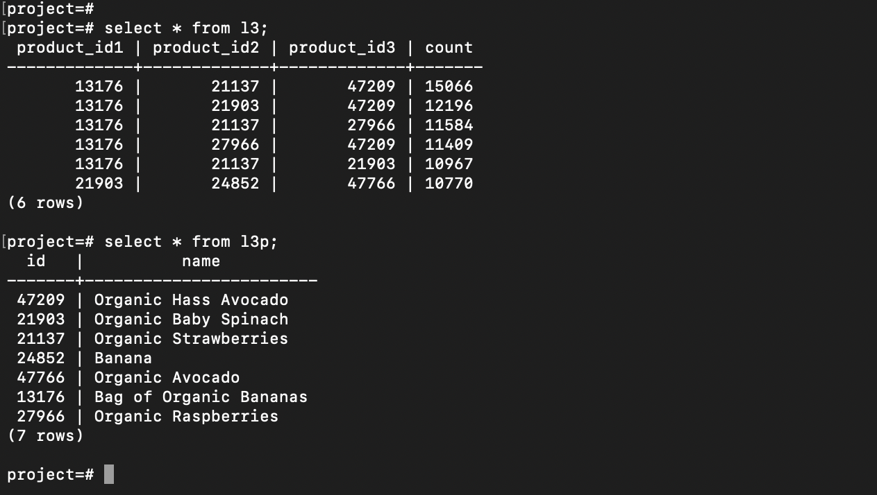

Slide 30
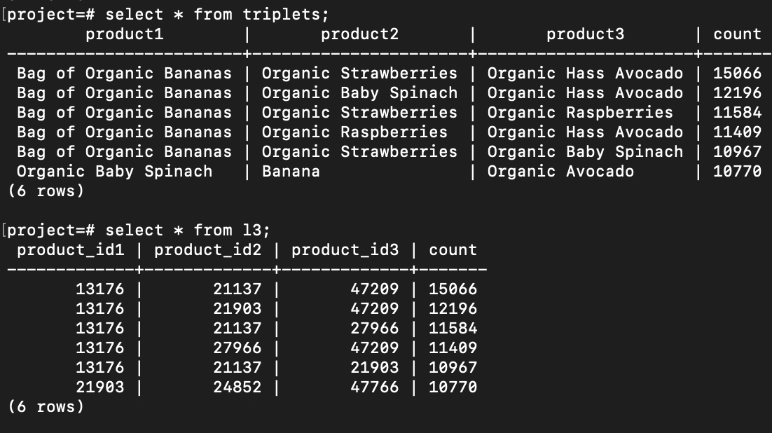

Slide 31
Which model is a best fit for our dataset
In the case of our project, the Instacart Market Basket Analysis dataset, a relational model is a better fit for the task of itemset mining to discover interesting association rules.
The dataset consists of structured data with well-defined entities such as orders, products, aisles, and departments. Each entity has its own set of attributes that can be easily mapped to columns in a relational database.
This makes it easy to create a schema that represents the entities and their relationships, as we described in our proposed schema.

Slide 32
CONTD.
Relational databases are designed for structured data and excel at handling large volumes of structured data with complex relationships. They also provide powerful query capabilities for joining and aggregating data from multiple tables, which is important for tasks such as itemset mining.
On the other hand, document-oriented databases are better suited for unstructured or semi-structured data that can vary in schema and format. They provide more flexibility in terms of schema design and can handle large volumes of data with high write and read throughput.
However, in the case of the Instacart dataset, the structured nature of the data and the well-defined relationships between entities make a relational model a more appropriate choice for itemset mining.

Slide 33
THANK YOU FOR YOUR TIME AND CONSIDERATION!

